Slide 1


2020 Behavioral Risk Surveillance System(BRFSS) Survey Data Mining
Professor: Jae Young Lee
Authors: Yidan Sun

Slide 2
Contents
01
02
03
04
05
06
Data Exploration
& Preprocessing
Data Partition
Feature Selection
Algorithms
Results
Conclusion

Slide 3

01
Introduction

Slide 4
Data Exploration
Background
Raw Data
The aggregate BRFSS combined landline and cell phone data set is built from the landline and cell phone data submitted for 2020 and includes data from 50 states, the District of Columbia, Guam, and Puerto Rico.
#Dataset: 5000
Personal data records
Label: depressive order Yes/No.
Attributes: state, date of birth, income, health test, race, marriage status, children, education, smoke….
Goal
Steps
R-Studio,Python
Preprocessing, choosing algorithms, data partition, data balance, attribute selection, 36 models parameter tuning and training, evaluate performance, result conclusion.
Use 6 algorithm and train 36 models to find the best model .
Compare Results and find the best model with highest accuracy or prediction.Metrics like Recall, Precision, F1, Accuracy…

Slide 5
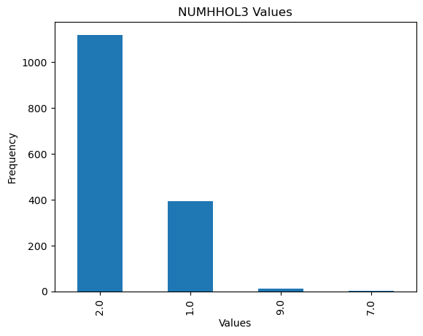
46.18%
197/275
143
Raw Data Exposure
Missing Values
Features with N/A
After Cleaning Features
Deletion Rules
Repeated Columns
None-Value Columns
Highly Correlated columns (collinearity check)
95% empty columns
Data Type
Categorical Data
Continuous Data
Most of data are highly skewed!

Slide 6
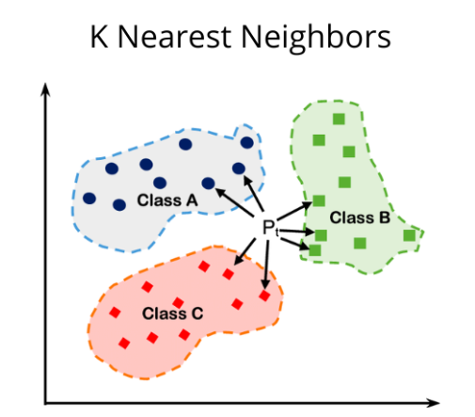
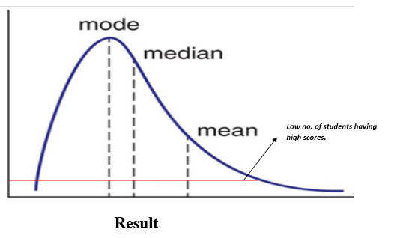
Raw Data Exposure
Most of features are highly skewed, since using median will be better than using mean to fill in N/A data
Method Approach
Use Median for fill in categorical features. Use Knn for fill in continuous features

Slide 7
02
Data Partition

Slide 8
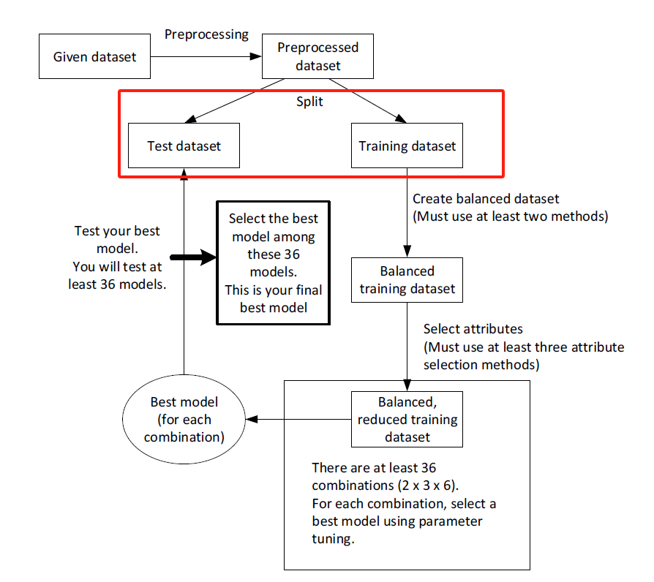
Dataset
Train:Test=8:2
Set.seed(123)
No(0);Yes(1)
3926：925
Class 0 ： Class 1

Slide 9
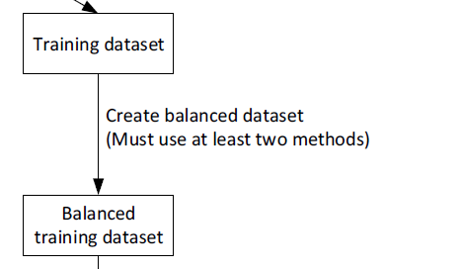
3143/3124
3143/738
738/738
3926/925
783/187
Data Partition
Oversample
Train Data
Class 0 / Class 1
8
Class 0 / Class 1
Undersample
Class 0 / Class 1
Class 0 / Class 1
2
Test Data
Class 0 / Class 1

Slide 10
03
Feature Selection

Slide 11
Three Selection Methods
Chi-Square
Classify Class to factor, find approach to apply chi-square test and extract p-value, then filter dataset based on threshold p-value <0.05.Filter out the selected attribute dataset
Anova F-test
Conduct ANOVA, extract the summary and then the p-value, threshold of p-value is 0.05.Select features based on a p-value threshold p < 0.05 and generated selected features.
Random Forest Variable Importance
Perform random forest variable importance, and extract the column corresponding to MeanDecreaseGini, Sort the importance measures and pick out the top 100 features. Choose the dataset with the 100 features as selected attributes.

Slide 12
6 balanced & reduced
train sets are ready for fitting models
#Feature selected | Chi Square | Anova F-test | Random Forest Variable Importance
Oversample | 53 Chi_Sq_1 | 96 Anov_F_1 | 100 RF_1
Undersample | 34 Chi_Sq_2 | 65 Anov_F_2 | 100 RF_2
Oversample subsets: Chi_Sq_1,Anov_F_1,RF_1
Undersample subsets: Chi_Sq_2,Anov_F_2,RF_2

Slide 13
04
Algorithms

Slide 14
Algorithms
Model Types
Tuning Process
Logistic Regression
Naive Bayes
J48 Decision Tree
C5 Decision Tree
Random Forest
Support Vector Machine (SVM)
Models were tuned uniquely for each dataset
Models were tuned across across a range of their hyperparameter features on the full training set when possible
For models with longer training times, random items from each set were selected and used

Slide 15
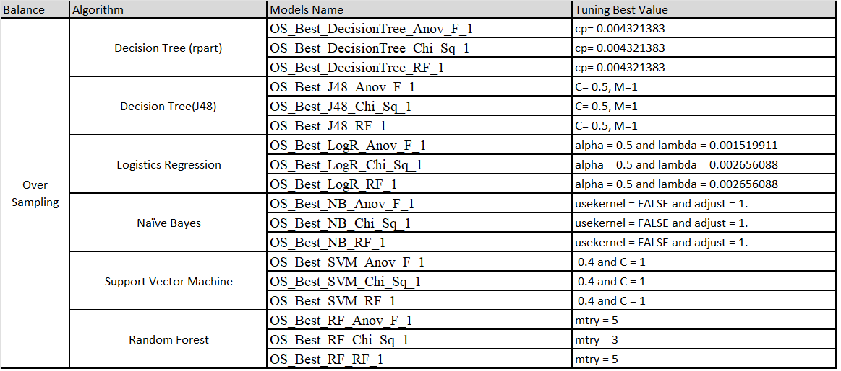
Model Parameter Tuning-Oversample

Slide 16
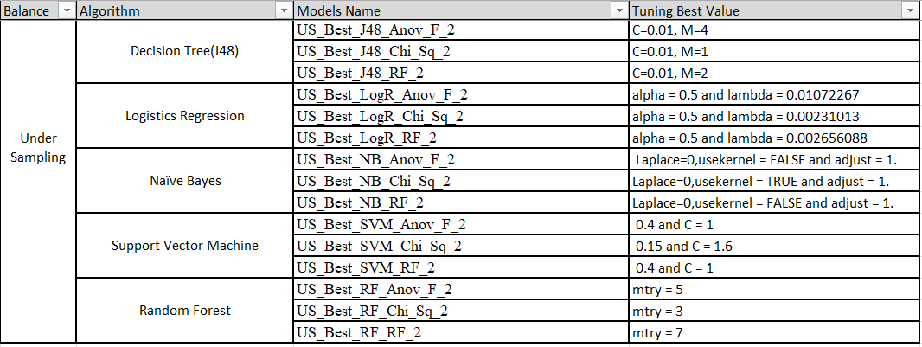
Model Parameter Tuning-Undersample

Slide 17
05
Results

Slide 18
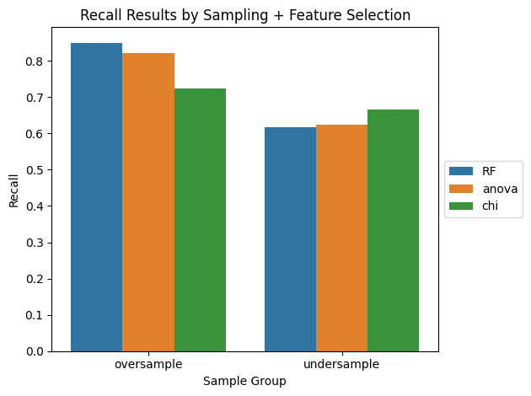
Best Training Dataset
Random Forest feature selection with oversampling of the under represented feature class generated the best results across all models
Chi Square was the best feature selection method with an undersampled example class
Oversampling the under represented class is the overall better methodology we found for this dataset

Slide 19
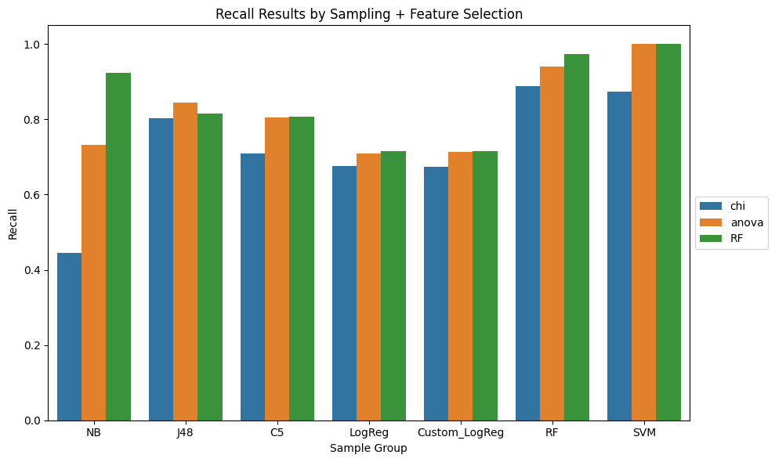
Recall Scores by Model and Feature Select

Slide 20
Model Comparison
Model | Feature Selection | Recall | Precision | F1 | Accuracy
SVM | ANOVA | 1.00 | 0.81 | 0.89 | 0.81
SVM | RF | 1.00 | 0.81 | 0.89 | 0.81
RF | RF | 0.97 | 0.83 | 0.90 | 0.82
RF | ANOVA | 0.94 | 0.85 | 0.89 | 0.82
NB | RF | 0.93 | 0.86 | 0.89 | 0.81
RF | Chi Square | 0.89 | 0.84 | 0.86 | 0.77
SVM | Chi Square | 0.87 | 0.84 | 0.86 | 0.77

Slide 21
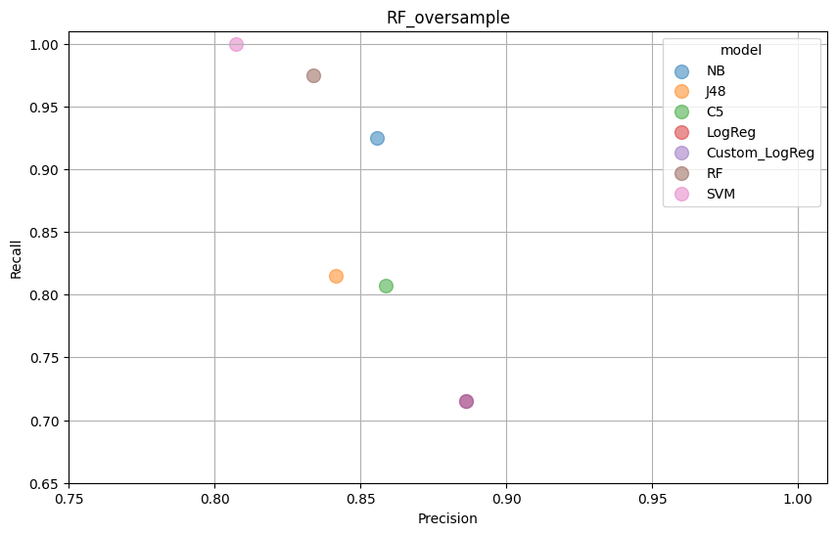
RF Feature Set Precision & Recall Results
Random Forest was best feature set
There is a clear trade off between precision and recall which is expected
The SVM model had a perfect recall score but the worst precision
Users could select the best model based on priority

Slide 22
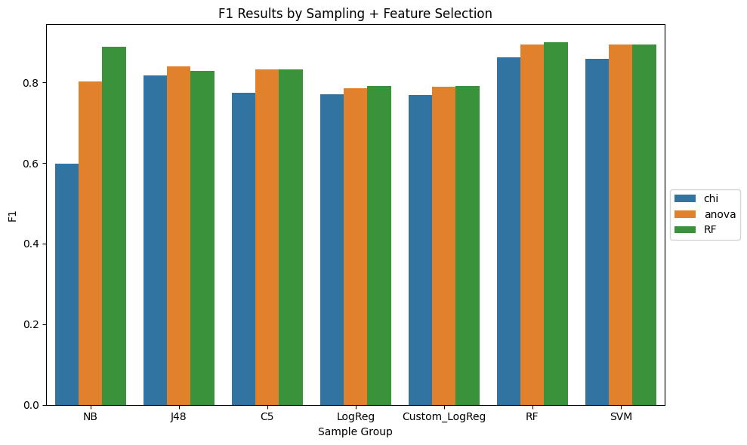
F1 Results

Slide 23
06
Conclusions

Slide 24
Results Discussion
Cleaning the dataset is a critical step of the process and none of the models would have worked effectively in the experiment without using the cleaning methods described here
If recall is the most important metric than oversampling the data, using Random Forest Feature Selection and the tuned SVM model provided will provide the best results .
But if we based on accuracy, Random Forest is better algorithm to used in the dataset.
Based on the needs of the user it might make more sense to recommend the Random Forest model for a small sacrifice in recall but with less false positives resulting in an equal F1.

Slide 25
Thanks!

